Slide 1
Bray Team Week 5 Update
Avery Haynes, Locke Lehmann, Travis Carlson, Cody Sims, Zachary Walker, Michael Hager
Week of 9/18/2023

Slide 2
Week 4 Tasks
Week 4 Tasks
Deliverable | Team Member | Percent Completed | Notes
Complete and turn in DR1 reports | All | 100%
HOQ for Bray | Locke | 80% | Need to complete roof of house, and review
HOQ team assignment | All | 100%
Clarify scope and priorities of project with Bray | All | 75% | Discuss with Bray how exactly their current solutions are applied, and what the next steps are

Slide 3
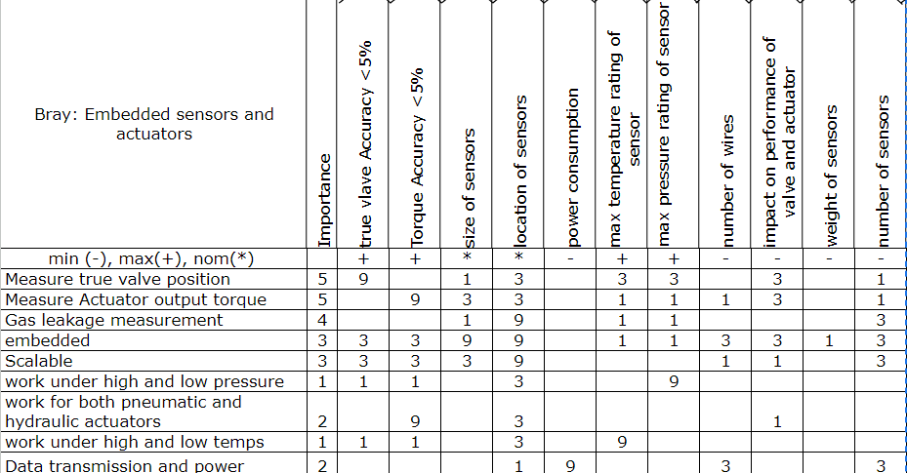

Slide 4
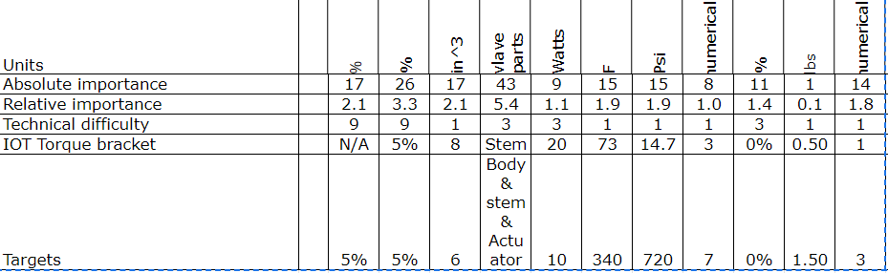

Slide 5
Week 5 Plans
Week 5 Tasks
Deliverable | Team Member | Percent Completed | Notes
Research potential strain gauges to use based on their applications, resolution, and cost | Avery | 100% | Bray suggested cylindrical or washer strain gauges
Look at SolidWorks models and gain deeper understanding into valves | Zack | 80% | Waiting ti get some more models
Stage 1 & 2 of function chain | Locke | 100% | Black box model and identify flows
Make update presentation by friday | Travis | 100%
Stage 3 of function chain | Cody | 20% | Got clarification
Stage 4 & 5 of function chain | Michael | 20% | Got clarification
Revise and edit DR1 reports | All | 40% | Need to put reports in drive and combine and review

Slide 6
Week 5 Issues/Needs
Look at SolidWorks models to understand valves better
Talk with Bray about how existing solutions work
Look at each others’ DR1 reports to revise and edit

